Slide 1

Assignment 1: Housing values

Slide 2
Assignment
Objectives
Deliverables
Are there differences in the Market Values of Occupied versus Vacant housing units?
Is there a pattern in these differences over the period 2005 through 2013?
Summarize the data for the VALUE and STATUS variables
Test for differences in the VALUE between ‘occupied’ and ‘vacant’ housing units
Do the above analysis separately for all five years, 2005 through 2013
Prepare a brief summary report, which includes the above information

Slide 3
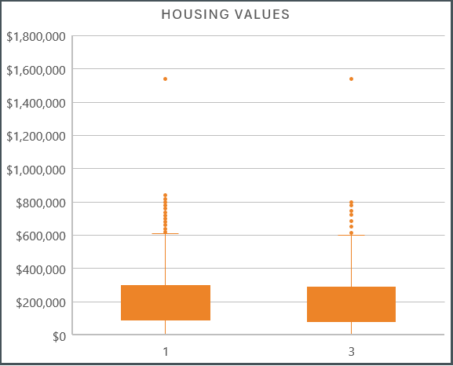
Analysis - 2005
 | Occupied | Unoccupied | All
Count | 29,440 | 1,074 | 30,514
Mean | $247,131 | $229,324 | $246,504
Median | $160,000 | $150,000 | $160,000
Mode | $200,000 | $1,540,794 | $200,000
Std Dev | $281,860 | $264,371 | $281,278
We can use a difference in means test to determine if there is a difference in the market value for occupied houses versus unoccupied houses:
H₀: μ_{occ} - μ_{unocc} = 0 t-stat = 2.0379 t-Cutoff = + / - 1.9600
We can reject the null hypothesis, meaning that our data shows there is a statistical difference in market value for occupied houses and unoccupied houses.

Slide 4
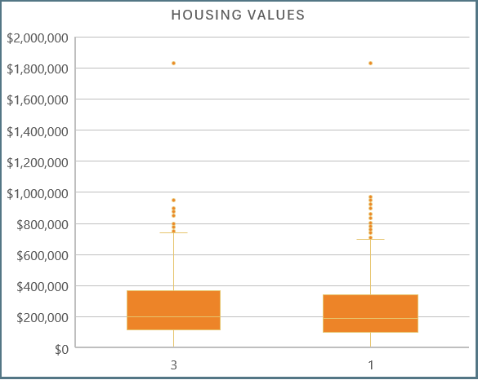
Analysis - 2007
 | Occupied | Unoccupied | All
Count | 26,466 | 1,319 | 27,785
Mean | $278,9617 | $289,004 | $279,438
Median | $190,000 | $200,000 | $190,000
Mode | $200,000 | $1,829,479 | $200,000
Std Dev | $317,163 | $306,204 | $316,653
We can use a difference in means test to determine if there is a difference in the market value for occupied houses versus unoccupied houses:
H₀: μ_{occ} - μ_{unocc} = 0 t-stat = -1.1243 t-Cutoff = + / - 1.9600
We cannot reject the null hypothesis, meaning that our data does not show a statistical difference in market value for occupied houses and unoccupied houses.

Slide 5
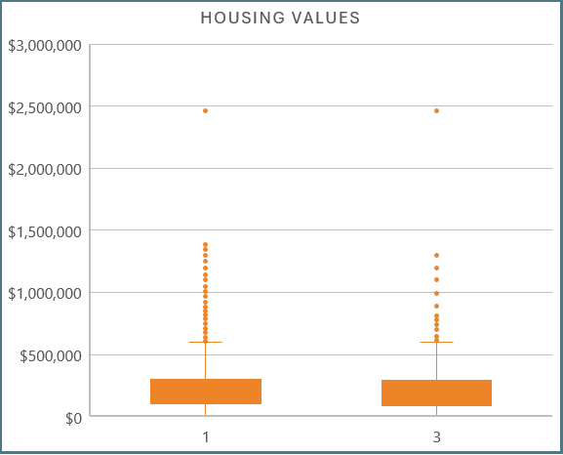
Analysis – 2009
 | Occupied | Unoccupied | All
Count | 30,081 | 1,236 | 31,317
Mean | $247,682 | $249,230 | $247,743
Median | $179,000 | $165,000 | $176,900
Mode | $200,000 | $200,000 | $200,000
Std Dev | $273,626 | $318,105 | $275,512
We can use a difference in means test to determine if there is a difference in the market value for occupied houses versus unoccupied houses:
H₀: μ_{occ} - μ_{unocc} = 0 t-stat = -0.1936 t-Cutoff = + / - 1.9600
We cannot reject the null hypothesis, meaning that our data does not show a statistical difference in market value for occupied houses and unoccupied houses.

Slide 6
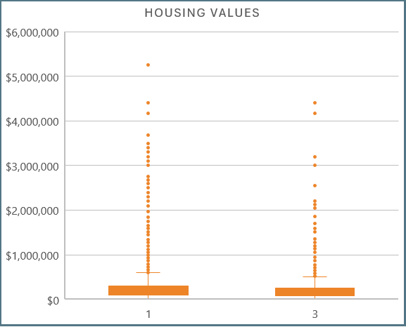
Analysis – 2011
 | Occupied | Unoccupied | All
Count | 82,078 | 2,972 | 85,050
Mean | $258,136 | $222,117 | $256,878
Median | $177,000 | $144,450 | $175,000
Mode | $200,000 | $200,000 | $200,000
Std Dev | $301,002 | $316,337 | $301,621
We can use a difference in means test to determine if there is a difference in the market value for occupied houses versus unoccupied houses:
H₀: μ_{occ} - μ_{unocc} = 0 t-stat = 6.3970 t-Cutoff = + / - 1.9600
We can reject the null hypothesis, meaning that our data shows there is a statistical difference in market value for occupied houses and unoccupied houses.

Slide 7
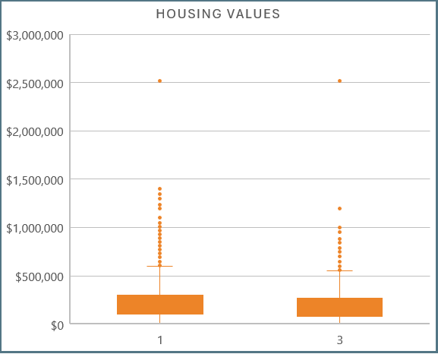
Analysis – 2013
 | Occupied | Unoccupied | All
Count | 35,418 | 1,257 | 36,675
Mean | $249,859 | $251,997 | $249,932
Median | $180,000 | $150,000 | $180,000
Mode | $150,000 | $150,000 | $150,000
Std Dev | $282,291 | $389,653 | $286,630
We can use a difference in means test to determine if there is a difference in the market value for occupied houses versus unoccupied houses:
H₀: μ_{occ} - μ_{unocc} = 0 t-stat = -0.2600 t-Cutoff = + / - 1.9600
We cannot reject the null hypothesis, meaning that our data does not show a statistical difference in market value for occupied houses and unoccupied houses.

Slide 8
Summary
Is there a difference in the market value between occupied and unoccupied houses?
The sample data for 2005 and 2011 shows a difference in market value in occupied and unoccupied houses.
The sample data for 2007, 2009, and 2013 do not allow us to reject the hypothesis that there is a difference in market values for occupied and unoccupied houses.

